Slide 1

CHAPTER - XIII MY SQL REVISION TOUR

Slide 2
INTRODUCTION
What is Database?
A relational database is, simply, a database that stores related information across multiple tables and allows you to query information in more than one table at the same time

Slide 3
ADVANTAGES OF DATABASE

Slide 4
ADVANTAGES OF DATABASE
1. REDUCING DATA REDUNDANCY
Data redundancy is the repetition or superfluity of data. Data redundancy data is an common issue in computer data storage and database systems. Data redundancy definition. Data redundancy in database means that some data fields are repeated in the database.

Slide 5
ADVANTAGES OF DATABASE
2. CONTROLING DATA INCONSISTENCY
Data inconsistency is a condition that occurs between files when similar data is kept in different formats in two different files, or when matching of data must be done between files. As a result of the data inconsistency, these files duplicate some data such as addresses and names, compromising data integrity.

Slide 6
ADVANTAGES OF DATABASE
3. ENFORCING STANDARDS
DBAs can enforce standards depending on the company’s IT policy. For e.g. standards for names, reports, data elements etc.

Slide 7
ADVANTAGES OF DATABASE
4. DATA SECURITY
Database security refers to the collective measures used to protect and secure a database or database management software from illegitimate use and malicious threats and attacks.

Slide 8
ADVANTAGES OF DATABASE
5. DATA SHARING
Company with several locations has important data distributed over a valid geographically area sharing.
A centralized database is physically contained to a single location controlled by a single computer that is Personal computer most function for which databases are created and accomplished more easily
Continued…

Slide 9
ADVANTAGES OF DATABASE
5. DATA SHARING
If the database is centralized and it is easily to update and back up , recovery and control access to a database . If we know database exactly where it is and what’s software control it and identify the remote place where it is located.

Slide 10
ADVANTAGES OF DATABASE
6. DATA INTEGRITY
Data integrity is the overall completeness, accuracy and consistency of data. This can be indicated by the absence of alteration between two instances or between two updates of a data record, meaning data is intact and unchanged.

Slide 11
DISADVANTAGES OF DATABASE

Slide 12
DISADVANTAGES OF DATABASE
1. DATABASE COMPLEXITY
The design of the database system is complex, difficult and is very time consuming task to perform.

Slide 13
DISADVANTAGES OF DATABASE
2. H/w AND S/w START-UP COSTS
Huge amount of investment is needed to setup the required hardware and the softwares needed to run those applications.

Slide 14
DISADVANTAGES OF DATABASE
3. DAMAGE TO DATABASE AFFECTS VIRTUALLY ALL APPLICATIONS PROGRAMS .
If one part of the database is corrupted or damaged because of the hardware or software failure, since we don’t have many versions of the file, all the application programs which are dependent on this database are implicitly affected.

Slide 15
DISADVANTAGES OF DATABASE
4. EXTENSIVE CONVERSION COSTS
In moving form a file-based system to a database system If you are currently working on file based system and need to upgrade it to database system, then large amount of cost is incurred in purchasing different tools, adopting different techniques as per the requirement.

Slide 16
DISADVANTAGES OF DATABASE
5. INITIAL TRAINING REQUIRED
Initial training required for all programmers and user. Large amount of human efforts, the time and cost is needed to train the end users and application programmers in order to get used to the database systems.

Slide 17
DATA MODELS

Slide 18
DATA MODEL
What is Data Model?
Data models define how the logical structure of a database is modelled. Data Models are fundamental entities to introduce abstraction in a DBMS. Data models define how data is connected to each other and how they are processed and stored inside the system.

Slide 19
TYPES OF DATA MODEL

Slide 20
TYPES OF DATA MODEL
1
2
3
1
2
3
RELATIONAL DATA MODEL
NETWORK DATA MODEL
HIERARCHICAL DATA
MODEL

Slide 21
1. RELATIONAL MODEL
Relational data model is the primary data model, which is used widely around the world for data storage and processing. This model is simple and have all the properties and capabilities required to process data with storage efficiency.

Slide 22
2. NETWORK MODEL. (Not in Syllabus)
Developed in mid 1960s as part of work of CODASYL (Conference on Data Systems Languages) which proposed programming language COBOL (1966) and then network model (1971). Objective of network model is to separate data structure from physical storage, eliminate unnecessary duplication of data with associated errors and costs. Continued…

Slide 23
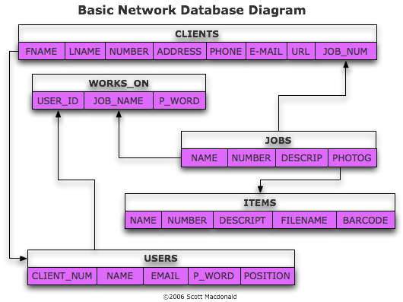
2. NETWORK MODEL. (Not in Syllabus)

Slide 24
2. NETWORK MODEL PRODUCTS IN MARKET
Integrated Data Store(IDS).
IDMS (Integrated Database Management System).
Raima Database Manager (RDM) Embeded.
RDM Server.
TurboIMAGE
Univac DMS – 1100.

Slide 25
3. Hierarchical Model. (Not in Syllabus)
Early 1960s, IBM saw business world organizing data in the form of a hierarchy.
Rather than one record type (flat file), a business has to deal with several types which are hierarchically related to each other
Continued...

Slide 26
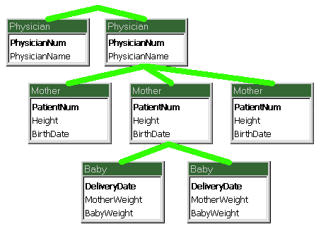
3. Hierarchical Model. (Not in Syllabus)

Slide 27
3. Hierarchical Model Products in the Market
DL/I (Data Language I) - By North American Rockwell and IBM.
IMS (Information Management System) - By North American Rockwell and IBM .

Slide 28
RELATIONAL MODEL

Slide 29
RELATIONAL MODEL
Edgar F. Codd. (19 August 1923 – 18 April 2003) was an English computer scientist who, while working for IBM
He invented the relational model for database management, the theoretical basis for relational databases and relational database management systems.

Slide 30
RELATIONAL MODEL
In the relational model, all data must be stored in relations (tables).
Each relation consists of rows and columns. Each relation must have a header and body.
The header is simply the list of columns in the relation. The body is the set of data that actually populates the relation, organized into rows.
1
2
3

Slide 31
RELATIONAL MODEL
The second major characteristic of the relational
model is the usage of keys.
These are specially designated columns within a
relation, used to order data or relate data to other
relations.
One of the most important keys is the primary key,
which is used to uniquely identify each row of data
Foreign keys relate data in one relation to the
primary key of another relation
4
5
6
7

Slide 32
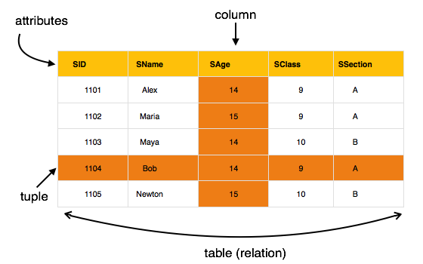
RELATIONAL MODEL

Slide 33
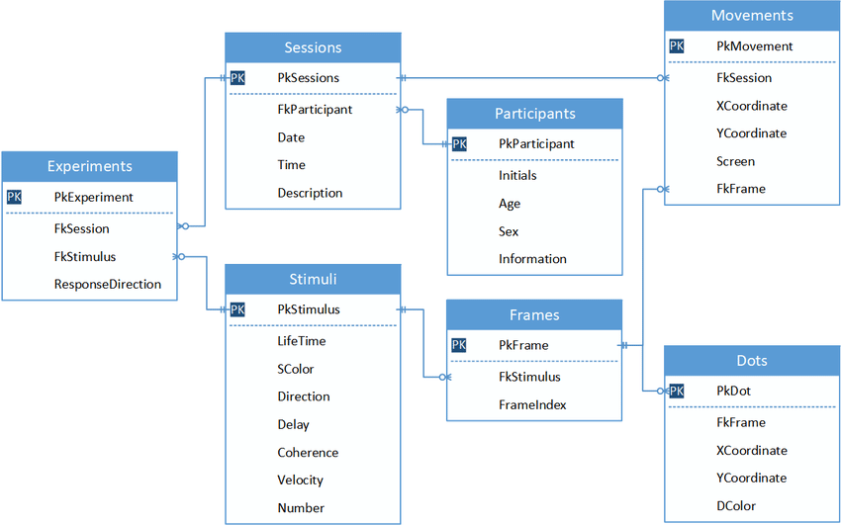
RELATIONAL MODEL

Slide 34
RELATIONAL MODEL SOFTWARES IN MARKET
Microsoft SQL Server
Microsoft SQL Server Express
SQL Azure (Cloud SQL Server)
Microsoft Visual FoxPro
Mimer SQL
MonetDB
mSQL
MySQL
OpenOffice.org Base
Netezza
NexusDB
NonStop SQL
NuoDB
Omnis Studio
Openbase
OpenLink Virtuoso (Open Source Edition)
OpenLink Virtuoso Universal Server
Wikipedia

Slide 35
RELATIONAL MODEL SOFTWARES IN MARKET
Oracle
Oracle Rdb for OpenVMS
Panorama
Paradox
Percona Server for MySQL
Percona XtraDB Cluster
Pervasive PSQL
Polyhedra
PostgreSQL
Postgres Plus Advanced Server
Progress Software
Raima Database Manager (RDM)
RDM Server
R:Base
SAND CDBMS
SAP HANA
SAP Adaptive Server Enterprise
Wikipedia

Slide 36
RELATIONAL MODEL TERMINOLOGIES

Slide 37
RELATIONAL MODEL TERMINOLOGIES
06
CARDINALITY
05
DEGREE
04
ENTITY
03
ATTRIBUTE
02
TUPLE
01
RELATION

Slide 38
RELATION
01
Relation is sometimes used to refer to a table in a relational database but is more commonly used to describe the relationships that can be created between those tables in a relational database.

Slide 39
TUPLE
02
A table has rows and columns, where rows represents records and columns represent the attributes. Tuple − A single row of a table, which contains a single record for that relation is called a tuple. Relation instance − A finite set of tuples in the relational database system represents relation instance.

Slide 40
ATTRIBUTE
03
The columns of table are known as attributes.

Slide 41
ENTITY
04
An entity is a real-world object that are represented in database. It can be any object, place, person or class. Data are stored about such entities. In DBMS we store data in the form of table containing information about entity type like students, teachers, employees etc..

Slide 42
DEGREE
05
The degree of relationship (also known as cardinality) is the number of occurrences in one entity which are associated (or linked) to the number of occurrences in another.

Slide 43
CARDINALITY
06
It is also called as Degree of relation Cardinality refers to the relationship between a row of one table and a row of another table. There are three degrees of relationship and they are:-
One to One (1:1)
2. One to Many (1:M)
3. Many to Many (M:M)

Slide 44
KEYS
KEYS

Slide 45
KEYS
A key is a field, or combination of fields, in a database table used to retrieve and sort rows in the table based on certain requirements. Keys are defined to speed up access to data and, in many cases, to create links between different tables.

Slide 46
KEYS
TYPES OF KEYS
KEYS

Slide 47
1
2
Super Key
Primary Key
KEYS
4
5
3
Alternate Key
Foreign Key
Candidate Key
7
8
6
Compound Key
Composite Key
Surrogate Key

Slide 48
KEYS
1
Super Key

Slide 49
1
Super Key
KEYS
A super key is a group of single or multiple keys which identifies rows in a table. A Super key may have additional attributes that are not needed for unique identification.
EmpSSN and EmpNum are superkeys.
EmpSSN | EmpNum | Empname
9812345098 | AB05 | Mark
9876512345 | AB06 | James

Slide 50
KEYS
2
Primary Key

Slide 51
2
Primary Key
KEYS
A column or group of columns in a table which helps us to uniquely identifies every row in that table is called a primary key. This DBMS can't be a duplicate. The same value can't appear more than once in the table
StudID | Roll No | First Name | LastName
1 | 11 | Rajesh | M
2 | 12 | Mohan | P
Student ID is the Primary Key

Slide 52
KEYS
3
Candidate Key

Slide 53
3
Candidate Key
KEYS
A super key with no repeated attribute is called candidate key. The Primary key should be selected from the candidate keys. Every table must have at least a single candidate key.
For Example:
Continued…

Slide 54
3
Candidate Key
KEYS
StudID | Roll No | First Name | LastName
1 | 11 | Krishna | M
2 | 12 | James | W
3 | 13 | Bolt | N
Stud ID, Roll No, are candidate keys which help us to uniquely identify the student record in the table

Slide 55
KEYS
4
Alternate Key

Slide 56
4
Alternate Key
KEYS
All the keys which are not primary key are called an alternate key. It is a candidate key which is currently not the primary key. However, A table may have single or multiple choices for the primary key.
For Example:
Continued…

Slide 57
4
Alternate Key
KEYS
StudID | Roll No | FName | LName | Email
1 | 11 | Ram | Price | abc@gmail.com
2 | 12 | Azar | Wright | xyz@gmail.com
StudID, Roll No, Email are qualified to become a primary key. But since StudID is the primary key, Roll No, Email becomes the alternative key.

Slide 58
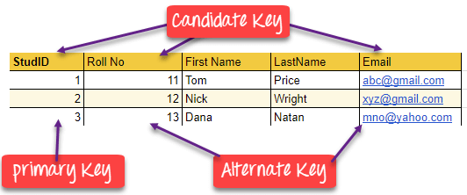
EXAMPLES
KEYS

Slide 59
KEYS
5
Foreign Key

Slide 60
5
Foreign Key
KEYS
A foreign key is a column which is added to create a relationship with another table. Foreign keys help us to maintain data integrity and also allows navigation between two different instances of an entity. Every relationship in the model needs to be supported by a foreign key.

Slide 61
5
KEYS
Foreign Key
DEPT TABLE
TEACHER TABLE
DeptCode | DeptName
001 | Science
002 | English
005 | Computer
Teacher ID | Fname | Lname
B002 | David | Warner
B017 | Sara | Joseph
B009 | Mike | Brunton

Slide 62
5
Foreign Key
KEYS
In this example, we have two table, teach and department in a school. However, there is no way to see which search work in which department.
In this table, adding the foreign key in Deptcode to the Teacher name, we can create a relationship between the two tables.

Slide 63
5
Foreign Key
KEYS
In this table, adding the foreign key in Deptcode to the Teacher name, we can create a relationship between the two tables.
TEACHER TABLE
Teacher ID | DeptCode | Fname | Lname
B002 | 002 | David | Warner
B017 | 002 | Sara | Joseph
B009 | 001 | Mike | Brunton

Slide 64
KEYS
5
2
Foreign Key
Vs.
Primary Key

Slide 65
5
2
Foreign Key
Vs.
Primary Key
KEYS
Primary Key | Foreign Key
Helps you to uniquely identify a record in the table. | It is a field in the table that is the primary key of another table.
Primary Key never accept null values. | A foreign key may accept multiple null values.
Continued…

Slide 66
5
2
KEYS
Foreign Key
Vs.
Primary Key
Primary Key | Foreign Key
Primary key is a clustered index and data in the DBMS table are physically organized in the sequence of the clustered index. | A foreign key cannot automatically create an index, clustered or non-clustered. However, you can manually create an index on the foreign key.
You can have the single Primary key in a table. | You can have multiple foreign keys in a table.

Slide 67
KEYS
6
Not in Syllabus
Compound Key

Slide 68
6
Not in Syllabus
Compound Key
KEYS
Compound key has many fields which allow you to uniquely recognize a specific record. It is possible that each column may be not unique by itself within the database. However, when combined with the other column or columns the combination of composite keys become unique.
Continued…

Slide 69
6
Not in Syllabus
Compound Key
KEYS
OrderNo | PorductID | Product Name | Quantity
B005 | JAP102459 | Mouse | 5
B005 | DKT321573 | USB | 10
B005 | OMG446789 | LCD Monitor | 20
OrderNo and ProductID can't be a primary key as it does not uniquely identify a record. However, a compound key of Order ID and Product ID could be used as it uniquely identified each record.

Slide 70
KEYS
7
Not in Syllabus
Composite Key

Slide 71
7
Not in Syllabus
Composite Key
KEYS
A key which has multiple attributes to uniquely identify rows in a table is called a composite key. The difference between compound and the composite key is that any part of the compound key can be a foreign key, but the composite key may or maybe not a part of the foreign key.

Slide 72
KEYS
8
Not in Syllabus
Surrogate Key

Slide 73
8
Not in Syllabus
Surrogate Key
KEYS
An artificial key which aims to uniquely identify each record is called a surrogate key. These kind of key are unique because they are created when you don't have any natural primary key. They do not lend any meaning to the data in the table. Surrogate key is usually an integer.

Slide 74
8
Not in Syllabus
Surrogate Key
KEYS
Fname | Lastname | Start Time | End Time
Anne | Smith | 09:00 | 18:00
Jack | Francis | 08:00 | 17:00
Anna | McLean | 11:00 | 20:00
shift timings of the different employee. In this example, a surrogate key is needed to uniquely identify each employee.

Slide 75
REFERENTIAL INTEGRITY
RI

Slide 76
REFERENTIAL INTEGRITY
RI
The data in a table that is not linked is probably of no value to other tables. To maintain referential integrity of data that is linked across tables.
Referential integrity (RI) is a relational database concept, which states that table relationships must always be consistent. In other words, any foreign key field must agree with the primary key that is referenced by the foreign key.

Slide 77

REFERENTIAL INTEGRITY
RI
You can set referential integrity when following conditions are met:-
The matching field from the primary table is the primary key
The related fields have the same data type
Both the tables belongs to the same database.

Slide 78
REFERENTIAL INTEGRITY
RI
You can set referential integrity when following conditions are met:-
The matching field from the primary table is the primary key
The related fields have the same data type
Both the tables belongs to the same database.

Slide 79
REFERENTIAL INTEGRITY
RI
After enforcing referential integrity you can observe the following rules:-
Not possible to enter value in the foreign key field of the related table that doesn’t exists in the primary key of the primary table.
You can’t delete a record from primary table if matching records exists in the related table.

Slide 80
REFERENTIAL INTEGRITY
RI
After enforcing referential integrity you can observe the following rules:-
you can’t change primary key value in primary table, if that record has related records

Slide 81


Slide 82

MYSQL INTRODUCTION
MySQL is an world’s most popular open source relational database.
MySQL is cross platform which means it runs on a number of different platforms such as Windows, Linux, and Mac OS etc.
MySQL is written in C and C++.
It was released under the name of co-founder Michael Widenius daughter, ‘My‘.

Slide 83
MYSQL HISTORY
MySQL was created by a Swedish company, MySQL AB, founded by David Axmark, Allan Larsson and Michael "Monty" Widenius.
Original development of MySQL by Widenius and Axmark began in 1994. The first version of MySQL appeared on 23 May 1995.
In 2010 Oracle acquired MYSQL.

Slide 84
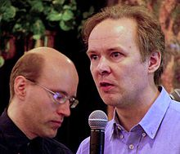
MYSQL HISTORY
Michael “Monty” Widenius
and
David Axmark
It was released under the name of co-founder Michael Widenius daughter, ‘My‘.

Slide 85
MYSQL SERVER AND MY SQL CLIENT

Slide 86
MYSQL SERVER and MYSQL CLIENT
The MYSQL SERVER package will install the mysql database server which you can interact with using a mysql client.
You can use the MYSQL CLIENT to send commands to any mysql server; on a remote computer or your own computer.

Slide 87
WHAT IS SQL?

Slide 88
SQL
SQL stands for Structured Query Language. It is designed for managing data in a relational database management system (RDBMS).
It is pronounced as S-Q-L or sometime See-Qwell. SQL is a database language.
it is used for database creation, deletion, fetching rows, and modifying rows, etc

Slide 89
SQL STATEMENTS

Slide 90
SQL STATEMENTS
SQL statements can be classified in to following categories:-
1. DATA DEFINITION LANGUAGE (DDL) COMMANDS
2. DATA MANIPULATION LANGUAGE (DML) COMMANDS
3. DATA CONTROL LANGUAGE (DCL) COMMANDS
4. TRANSACTION CONTROL LANGUAGE (TCL) COMMANDS

Slide 91

1. DATA DEFINITION LANGUAGE (DDL) COMMANDS
Data Definition Language actually consists of the SQL commands that can be used to define the database schema. Followings are the commands which fall under DDL category :-
CREATE TABLE
DROP TABLE
ALTER TABLE
TRUNCATE
COMMENT
RENAME

Slide 92
2. DATA MANIPULATION LANGUAGE (DML) COMMANDS
The SQL commands that deals with the manipulation of data are DML Commands. Followings commands fall under the DML Commands category:-
SELECT
INSERT
UPDATE
DELETE
MERGE
CALL

Slide 93

3. DATA CONTROL LANGUAGE (DCL) COMMANDS
DCL is short name of Data Control Language mostly concerned with rights, permissions and other controls of the database system. Followings commands fall under the DML Commands category:-.
GRANT
REVOKE

Slide 94
4. TRANSACTION CONTROL LANGUAGE (TCL) COMMANDS
TCL is short name of Transaction Control Language which deals with a transaction within a database. Followings commands fall under the DML Commands category:-.
COMMIT
ROLLBACK
SAVEPOINT
SET TRANSACTION

Slide 95
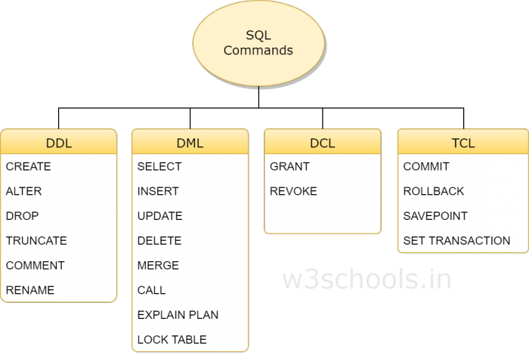
SUMMARY
Reference: w3schools.in

Slide 96
DATA TYPES

Slide 97
DATA TYPES
Ty p e | S i z e | D e s c r i p t i o n
CHAR[Length] | Length bytes | 0 to 255 characters long.
VARCHAR (Length) | String length + 1 bytes | 0 to 255 characters long.
TINYTEXT | String length + 1 bytes | maximum length of 255 characters.

Slide 98
DATA TYPES
Ty p e | S i z e | D e s c r i p t i o n
TEXT | String length + 2 bytes | maximum length of 65,535 characters.
MEDIUMTEXT | String length + 3 bytes | maximum length of 16,777,215 characters.
LONGTEXT | String length + 4 bytes | maximum length of 4,294,967,295 characters.

Slide 99
DATA TYPES
Ty p e | S i z e | D e s c r i p t i o n
TEXT | String length + 2 bytes | maximum length of 65,535 characters.
MEDIUMTEXT | String length + 3 bytes | maximum length of 16,777,215 characters.
LONGTEXT | String length + 4 bytes | maximum length of 4,294,967,295 characters.
TINYINT[Length] | 1 byte | Range of -128 to 127 or 0 to 255 unsigned.

Slide 100
DATA TYPES
Ty p e | S i z e | D e s c r i p t i o n
SMALLINT[Length] | 2 bytes | Range of -32,768 to 32,767 or 0 to 65535 unsigned.
MEDIUMINT[Length] | 3 bytes | Range of -8,388,608 to 8,388,607 or 0 to 16,777,215 unsigned.
INT[Length] | 4 bytes | Range of -2,147,483,648 to 2,147,483,647 or 0 to 4,294,967,295 unsigned.

Slide 101
DATA TYPES
Ty p e | S i z e | D e s c r i p t i o n
BIGINT[Length] | 8 bytes | Range of -9,223,372,036,854,775,808 to 9,223,372,036,854,775,807 or 0 to 18,446,744,073,709,551,615 unsigned.

Slide 102
DATA TYPES
Ty p e | S i z e | D e s c r i p t i o n
FLOAT | 4 bytes | A small number with a floating decimal point.
DOUBLE[Length, Decimals] | 8 bytes | A large number with a floating decimal point.
DECIMAL[Length, Decimals] | Length + 1 or Length + 2 bytes | A DOUBLE stored as a string, allowing for a fixed decimal point.

Slide 103
DATA TYPES
Ty p e | S i z e | D e s c r i p t i o n
TIME | 3 bytes | In the format of HH:MM:SS
ENUM | 1 or 2 bytes | Short for enumeration, which means that each column can haveone of several possible values.
SET | 1, 2, 3, 4, or 8 bytes | Like ENUM except that each column can have more than one of several possible values.

Slide 104
DATA TYPES
Ty p e | S i z e | D e s c r i p t i o n
DATE | 3 bytes | In the format of YYYY-MM-DD.
DATETIME | 8 bytes | In the format of YYYY-MM-DD HH:MM:SS.
TIMESTAMP | 4 bytes | In the format of YYYYMMDDHHMMSS; acceptable range ends inthe year 2037.

Slide 105
DATA TYPES
Ty p e | S i z e | D e s c r i p t i o n
TIME | 3 bytes | In the format of HH:MM:SS
ENUM | 1 or 2 bytes | Short for enumeration, which means that each column can haveone of several possible values.
SET | 1, 2, 3, 4, or 8 bytes | Like ENUM except that each column can have more than one ofseveral possible values.

Slide 106
CHAR vs. VARCHAR DATA TYPE

Slide 107
CHAR vs. VARCHAR DATA TYPE
CHAR Data Type | VARCHAR Data Type
Its full name is CHARACTER | Its full name is VARIABLE CHARACTER
It stores values in fixed lengths and are padded with space characters to match the specified length | VARCHAR stores values in variable length along with 1-byte or 2-byte length prefix and are not padded with any characters
It can hold a maximum of 255 characters. | It can hold a maximum of 65,535 characters.
It uses static memory allocation.mysql>create table emp(name CHAR(20)); Query OK, 0 rows affected (0.25 | It uses dynamic memory allocation.mysql>create table emp1(name VARCHAR(20)); Query OK, 0 rows affected (0.21

Slide 108
CREATING DATABASE IN MYSQL

Slide 109
CREATING DATABASE IN MYSQL
MySQL implements a database as a directory that contains all files which correspond to tables in the database.
CREATE DATABASE mydb;
Return value:
Query OK, 1 row affected (0.05 sec)

Slide 110
USING OR ACCESSING CREATED DATABASE

Slide 111
USING OR ACCESSING CREATED DATABASE
Using the created database mydb
USE mydb;
Return value:
Database Changed

Slide 112
CREATING TABLES WITH CREATE TABLE
CATEGORY: DDL COMMAND

Slide 113
CREATING TABLES WITH CREATE TABLE
Creating a table in MySQL
CREATE TABLE mytable
(
id int unsigned NOT NULL auto_increment,
username varchar(100) NOT NULL,
email varchar(100) NOT NULL,
PRIMARY KEY (id)
);
Query OK, 0 rows affected (0.10 sec)

Slide 114
TABLE CREATION WITH PRIMARY KEY
CATEGORY: DDL COMMAND

Slide 115
TABLE CREATION WITH PRIMARY KEY
Creating a table in MySQL
CREATE TABLE Person (
PersonID INT UNSIGNED NOT NULL PRIMARY KEY,
LastName VARCHAR(66) NOT NULL,
FirstName VARCHAR(66),
Address VARCHAR(255),
City VARCHAR(66)
);

Slide 116
TABLE CREATION WITH PRIMARY KEY
Creating a table in MySQL
CREATE TABLE Person (
PersonID INT UNSIGNED NOT NULL,
LastName VARCHAR(66) NOT NULL,
FirstName VARCHAR(66),
Address VARCHAR(255),
City VARCHAR(66),
PRIMARY KEY (PersonID)
);

Slide 117
TABLE CREATION WITH FOREIGN KEY
CATEGORY: DDL COMMAND

Slide 118
TABLE CREATION WITH FOREIGN KEY
Creating a table in MySQL
CREATE TABLE Account (
AccountID INT UNSIGNED NOT NULL,
AccountNo INT UNSIGNED NOT NULL,
PersonID INT UNSIGNED,
PRIMARY KEY (AccountID),
FOREIGN KEY (PersonID) REFERENCES Person (PersonID)
);

Slide 119
TABLE CREATION WITH FOREIGN KEY
ON CASCADE DELETE
CATEGORY: DDL COMMAND

Slide 120
ON CASCADE DELETE
If a row or tuple deleted from parent table, all its related tuples or rows in the child table will automatically deleted.
CREATE TABLE Account (
AccountID INT UNSIGNED NOT NULL,
AccountNo INT UNSIGNED NOT NULL,
PersonID INT UNSIGNED,
PRIMARY KEY (AccountID),
FOREIGN KEY (PersonID) REFERENCES Person (PersonID) ON CASCADE DELETE
);

Slide 121
TABLE CREATION WITH FOREIGN KEY
ON CASCADE UPDATE
CATEGORY: DDL COMMAND

Slide 122
ON CASCADE UPDATE
If a row or tuple updated from parent table, all its related tuples or rows in the child table will automatically deleted.
CREATE TABLE Account (
AccountID INT UNSIGNED NOT NULL,
AccountNo INT UNSIGNED NOT NULL,
PersonID INT UNSIGNED,
PRIMARY KEY (AccountID),
FOREIGN KEY (PersonID) REFERENCES Person (PersonID) ON CASCADE DELETE ON CASCADE UPDATE);

Slide 123
TABLE CREATION WITH UNIQUE KEY
CATEGORY: DDL COMMAND

Slide 124
TABLE CREATION WITH UNIQUE KEY
Creating a table in MySQL
CREATE TABLE Account (
AccountID INT UNSIGNED NOT NULL,
AccountNo INT UNSIGNED NOT NULL UNIQUE,
PersonID INT UNSIGNED,
PRIMARY KEY (AccountID),
FOREIGN KEY (PersonID) REFERENCES Person (PersonID)
);

Slide 125
TABLE CREATION WITH DEFAULT CONSTRAINT
CATEGORY: DDL COMMAND

Slide 126
TABLE CREATION WITH DEFAULT CONSTRAINT
DEFAULT CONSTRAINT in MySQL
CREATE TABLE student
(
Rollno int not null primary key,
Studname char(50) not null
default ‘sainik’
Marks decimal
);

Slide 127
TABLE CREATION WITH CHECK CONSTRAINT
CATEGORY: DDL COMMAND

Slide 128
TABLE CREATION WITH CHECK CONSTRAINT
CHECK CONSTRAINT in MySQL
CREATE TABLE student
(
Rollno int not null primary key,
Studname char(50) not null
default ‘sainik’
Marks decimal CHECK(Marks>=0)
);

Slide 129
TABLE LEVEL CONSTRAINT
CATEGORY: DDL COMMAND

Slide 130
TABLE LEVEL CONSTRAINT
When a constraint is applied on group of columns of the table, it is called TABLE LEVEL CONSTRAINT.
CREATE TABLE products(
Icode int not null,
Descrip char(25),
Cost decimal
Qty int,
Totcost float,
CHECK (QTY>0),
UNIQUE(Icode,Ddescrip) ) ;

Slide 131
COLUMN LEVEL CONSTRAINT
CATEGORY: DDL COMMAND

Slide 132
COLUMN LEVEL CONSTRAINT
When a constraint is applied on specific column of the table, it is called COLUMN LEVEL CONSTRAINT.
CREATE TABLE products(
Icode int not null, primary key
Descrip char(25),
Cost decimal;

Slide 133
INSERTING ROWS OR TUPLES IN TABLE
CATEGORY: DML COMMAND

Slide 134
INSERTING ROWS OR TUPLES IN TABLE
CATEGORY: DML COMMAND
Inserting a row into a MySQL table
INSERT INTO mytable ( username, email )
VALUES ( 'username', 'username@example.com' );
Query OK, 1 row affected (0.06 sec)
NOTE: STRINGS and date are represented in single quotes.

Slide 135
UPDATING ROWS OR TUPLES IN TABLE
CATEGORY: DML COMMAND

Slide 136
UPDATING ROWS OR TUPLES IN TABLE
CATEGORY: DML COMMAND
Updating a row into a MySQL table
UPDATE mytable SET username=‘myuser’ WHERE id=8
Query OK, 1 row affected (0.06 sec)

Slide 137
DELETING A ROW INTO A MYSQL TABLE
CATEGORY: DML COMMAND

Slide 138
DELETING A ROW INTO A MYSQL TABLE
CATEGORY: DML COMMAND
Deleting a row into a MySQL table
DELETE FROM mytable WHERE id=8
Query OK, 1 row affected (0.06 sec)

Slide 139
ALTER TABLE in MySQL
CATEGORY: DML COMMAND

Slide 140
MODIFY COLUMN OF MYSQL TABLE
CATEGORY: DML COMMAND
ALTER TABLE is used to add/modify/rename the column definition of existing table.
For Example:-
Create table UserTable2019(
id_user int NOT NULL,
username varchar(30) NOT NULL,
password varchar(30) NOT NULL
);

Slide 141
MODIFY COLUMN OF MYSQL TABLE
CATEGORY: DML COMMAND
ALTER TABLE UserTable2019
MODIFY (
username varchar(45) NOT NULL,
password varchar(35) NOT NULL
));
Username column size changed from 30 to 45 and password column size is changed from 30 to 35.

Slide 142
ADDING COLUMN in MySQL TABLE
CATEGORY: DML COMMAND

Slide 143
ADDING COLUMN IN MYSQL TABLE
CATEGORY: DML COMMAND
ALTER TABLE is used to add/modify/rename the column definition of existing table.

Slide 144
ADDING COLUMN IN MYSQL TABLE
CATEGORY: DML COMMAND
ALTER TABLE UserTable2019
ADD (
address varchar(45) NOT NULL,
Phone_no varchar(35) NOT NULL
));
address and Phone_no are new columns introduced in UserTable2019.

Slide 145
CHANGING COLUMN NAME OF MySQL TABLE
CATEGORY: DML COMMAND

Slide 146
CHANGING NAME OF COLUMN OF MYSQL TABLE
CATEGORY: DML COMMAND
ALTER TABLE is used to change the column name of existing table.
ALTER TABLE UserTable2019
CHANGE address addr varchar(45));

Slide 147
CREATE TABLE FROM SELECT
CATEGORY: DDL COMMAND

Slide 148
CREATE TABLE FROM SELECT
CATEGORY: DDL COMMAND
You can create a table from SELECT clause.
For Example:
CREATE TABLE Usr_Tab2019
AS SELECT * FROM User_table2019;

Slide 149
DROPPING MYSQL TABLE
CATEGORY: DML COMMAND

Slide 150
DROPPING MYSQL TABLE
CATEGORY: DML COMMAND
DROP TABLE command is used to drop the table.
DROP TABLE Tablename
For Example:
DROP TABLE UserTable2019
NOTE: Dropping table will completely delete the table from the database and all its information, and it will not be recovered.

Slide 151
SELECT QUERY in MySQL
CATEGORY: DML COMMAND

Slide 152
SELECT QUERY in MySQL
CATEGORY: DML COMMAND
SELECTING ALL ROWS WITH ALL COLUMNS

Slide 153
SELECT QUERY in MySQL
CATEGORY: DML COMMAND
Selecting all tuples with all attributes in MySQL
SELECT * FROM mytable;
OUTPUT
+----+----------+---------------------+
| id | username | email |
+----+----------+---------------------+
| 1 | myuser | myuser@example.com |
+----+----------+---------------------+

Slide 154
SELECT QUERY in MySQL
CATEGORY: DML COMMAND
PARTICULAR COLUMNS SELECTION IN MYSQL

Slide 155
SELECT QUERY in MySQL
CATEGORY: DML COMMAND
Selected particular columns in MySQL
SELECT username FROM mytable;
OUTPUT
+----------+
| username |
+----+-----+
| myuser |
|----------+

Slide 156
SELECT QUERY in MySQL
CATEGORY: DML COMMAND
SELECTING ROWS BASED ON CONDITIONS

Slide 157
SELECT QUERY in MySQL
CATEGORY: DML COMMAND
Selecting rows based on conditions in MySQL
SELECT * FROM mytable WHERE username = ‘myuser’;
OUTPUT
+----+----------+---------------------+
| id | username | email |
+----+----------+---------------------+
| 1 | myuser | myuser@example.com |
+----+----------+---------------------+

Slide 158
SELECT QUERY in MySQL
CATEGORY: DML COMMAND
SELECT with DISTINCT

Slide 159
SELECT QUERY in MySQL
CATEGORY: DML COMMAND
SELECT with DISTINCT
The DISTINCT clause after SELECT eliminates duplicate rows from the result set.
CREATE TABLE car
( car_id INT UNSIGNED NOT NULL PRIMARY KEY, name VARCHAR(20),
price DECIMAL(8,2)
);

Slide 160
SELECT QUERY in MySQL
CATEGORY: DML COMMAND
SELECT with DISTINCT
INSERT INTO CAR (`car_id`, `name`, `price`) VALUES (1, 'Audi A1', '20000');
INSERT INTO CAR (`car_id`, `name`, `price`) VALUES (2, 'Audi A1', '15000');
INSERT INTO CAR (`car_id`, `name`, `price`) VALUES (3, 'Audi A2', '40000');
INSERT INTO CAR (`car_id`, `name`, `price`) VALUES (4, 'Audi A2', '40000');

Slide 161
SELECT QUERY in MySQL
CATEGORY: DML COMMAND
SELECT with DISTINCT
SELECT DISTINCT nameFROM CAR;
+---------+
| name |
+---------+
| Audi A1 |
| Audi A2 |
+---------+

Slide 162
SELECT QUERY in MySQL
CATEGORY: DML COMMAND
SELECT with DISTINCT
SELECT DISTINCT name, price FROM CAR;
+---------+----------+
| name | price |
+---------+----------+
| Audi A1 | 20000.00 |
| Audi A1 | 15000.00 |
| Audi A2 | 40000.00 |
+---------+----------+

Slide 163
SELECT QUERY in MySQL
CATEGORY: DML COMMAND
ALL Keyword

Slide 164
SELECT QUERY in MySQL
CATEGORY: DML COMMAND
ALL Keyword
SELECT ALL name FROM CAR;
+---------+
| name |
+---------+
| Audi A1 |
| Audi A1 |
| Audi A2 |
+---------+

Slide 165
DESCRIBE COMMAND

Slide 166
DESCRIBE COMMAND
Describe command is used to show all the fields of a table
All the details. (structure of the table)
DESCRIBE databaseName.tableName;
Or
DESCRIBE tablename;

Slide 167
DESCRIBE COMMAND
mysql> DESCRIBE orders;
+----------------+-------------+------+-----+---------+-------+-------+
| Field | Type | Null | Key | Default | Extra |
+---------------------+------+------+-----+---------+-------+---------+
| orderNumber | int(11) | NO | PRI | NULL | |
| orderDate | date | NO | | NULL | |
| requiredDate | date | NO | | NULL | |
| shippedDate | date | YES | | NULL | |
| 4 rows in set (0.01 sec)

Slide 168
SHOW LIST OF EXISTING DATABASES

Slide 169
SHOW LIST OF EXISTING DATABASES
SHOW databases;
-------------------------------+
| Databases |
+-----------------------------+
| employeees |
| mydb |
+-----------------------------+

Slide 170
SHOW TABLES IN AN EXISTING DATABASE

Slide 171
SHOW TABLES IN AN EXISTING DATABASE
SHOW tables;
-------------------------------+
| Tables_in_mydb |
+-----------------------------+
|mytable |
+-----------------------------+

Slide 172
CREATING USER

Slide 173
CREATING USER- FROM LOCAL

Slide 174
CREATING USER- FROM LOCAL
CREATE USER 'user'@'localhost' IDENTIFIED BY 'some_password';
Will create a user that can only connect on the local machine where the database is hosted.

Slide 175
CREATING USER - FROM ANYWHERE

Slide 176
CREATING USER - FROM ANYWHERE
CREATE USER 'user'@'%' IDENTIFIED BY 'some_password';
Will create a user that can connect from anywhere (except the local machine).

Slide 177
GRANT OR ADDING PRIVILEGES

Slide 178
GRANT OR ADDING PRIVILEGES
CATEGORY: DCL COMMAND
GRANTING SPECIFIC PRIVILEGES
SELECT
INSERT
UPDATE
DELETE
CREATE
DROP
GRANT SELECT, INSERT, UPDATE ON databaseName.* TO 'userName'@'localhost‘;

Slide 179
GRANT ALL PRIVILEGES

Slide 180
GRANT ALL PRIVILEGES
CATEGORY: DCL COMMAND
GRANTING ALL PRIVILEGES
Grant all privileges to the user for all tables on all databases (attention with this):
GRANT ALL ON *.* TO 'userName'@'localhost' WITH GRANT OPTION;

Slide 181
GRANT ALL PRIVILEGES
CATEGORY: DCL COMMAND
GRANTING ALL PRIVILEGES
Grant all privileges to the user for all tables on all databases (attention with this):
GRANT ALL ON *.* TO 'userName'@'localhost' WITH GRANT OPTION;

Slide 182
PREDICATES

Slide 183
PREDICATES
Predicate operations are operations that can be evaluated to give a condition of true or false and are used in WHERE clause of SELECT statement:
1. "Comparison" Predicates: Compares two values of the same type according to a predefined order. There are 6 comparison operations:
Equal: value = value
Not Equal: value <> value
Less Than: value < value
Greater Than: value > value
Less Than or Equal: value <= value
Greater Than or Equal: value >= value

Slide 184
PREDICATES
"Comparison" Predicates Example:
1. SELECT * FROM EMPLOYEE
WHERE
SAL>=6700
2. SELECT * FROM EMPLOYEE
WHERE
Dept=‘Comp Sci’

Slide 185
PREDICATES
2. "Between" Predicates: Check a given value against a value range. There are 2 "between" operations:
Between: value BETWEEN value AND value
Not Between: value NOT BETWEEN value AND value

Slide 186
PREDICATES
"Between" Predicate Example:
SELECT * FROM stud WHERE id >= 2 and id <= 5;
This query can be written as,
SELECT * FROM stud WHERE id BETWEEN 2 and 5;
NAGATE:
SELECT * FROM stud WHERE id NOT BETWEEN 2 and 5

Slide 187
PREDICATES
3. "In" Predicates: Check a given value against a list of values. There are 2 "in" operations:
In: value IN (value, value, ..., value)
Not In: value NOT IN (value, value, ..., value)

Slide 188
PREDICATES
. "In" Predicates Example:
SELECT * FROM STUD WHERE ROLLO IN (1001, 1002,1003,1010)
NOT IN:
SELECT * FROM STUD WHERE ROLLO NOT IN (1006, 1089,1008,1016)

Slide 189
PREDICATES
4. "Like" Predicates: Check a given character string against a character pattern. By default "Like" operations are not case sensitive. There are 2 "Like" operations:
Like: string LIKE pattern
Not Like: string NOT LIKE pattern
Continued…

Slide 190
PREDICATES
"pattern" is a character string with wildcard characters and escape sequences:
"_": Representing one and only one single character.
"%": Representing zero, one and many characters.
"\_": Representing character "_".
"\%": Representing character "%".
Continued…

Slide 191
PREDICATES
Examples:
'abc' LIKE 'Abc' -- true
'3.14' LIKE '_.__' – true
'3.14159' LIKE '3.%‘ -- true
'herong_yang' LIKE 'herong\_yang‘ – true
'4.75%' LIKE '_.__\%' -- true

Slide 192
PREDICATES
Examples:
SELECT * FROM stud_users WHERE username LIKE ‘adm%’;
SELECT * FROM stud_users WHERE username LIKE ‘%adm%’;
SELECT * FROM stud_users WHERE username LIKE ‘_a___’;

Slide 193
PREDICATES
5. "Null" Predicates: Check a given value against null value. There are 2 "Null" operations:
Null : value IS NULL
Not Null : value IS NOT NULL
Examples:
1 IS NULL -- false
'a' IS NOT NULL -- true
NULL IS NULL -- true
NULL IS NOT NULL -- false

Slide 194
MYSQL JOINS

Slide 195
MYSQL JOINS
SQL
A SQL Join Or MySQL JOINS are used to retrieve data from multiple tables. A MySQL JOIN is performed whenever two or more tables are joined in a SQL statement.
Types of Joins are:-
CROSS JOIN
INNER JOIN
EQUI JOIN
NATURAL JOIN
LEFT JOIN
RIGHT JOIN

Slide 196
MYSQL JOINS
CROSS JOIN OR
SQL
CARTESIAN JOIN

Slide 197
CROSS JOIN
SQL
Cross JOIN Or CARTESIAN JOIN is a simplest form of JOINs which matches each row from one database table to all rows of another.
In other words it gives us combinations of each row of first table with all records in second table.

Slide 198
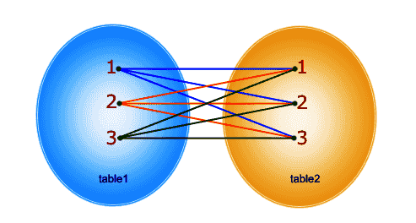
CROSS JOIN
SQL
SELECT * FROM students CROSS JOIN
teachers

Slide 199
MYSQL JOINS
SQL
INNER JOIN

Slide 200
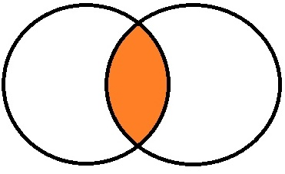
INNER JOIN
SQL
The inner JOIN is used to return rows from both tables that satisfy the given condition.

Slide 201
SQL
INNER JOIN
SELECT members.first_name , members.last_name , movies.title
FROM members ,movies
WHERE movies.id = members.movie_id
This can be written as,
SELECT A.first_name , A.last_name , B.title FROM members AS A INNER JOIN movies AS B ON B. id = A.movie_id

Slide 202
MYSQL JOINS
SQL
EQUI JOIN

Slide 203
SQL
EQUI JOIN
OUTER JOIN
LEFT JOIN
RIGHT JOIN

Slide 204
COMMENTS

Slide 205
COMMENTS
Comments are non executable statements and are used to explain the code or commands. MYSQL supports three types of comments and they are:-
1. # This comment continues to the end of line
2. /* This is an in-line comment */
3. /* This is a
multiple-line comment */

Slide 206
SQL Exercises

Slide 207
CREATE WORKER TABLE
WORKER_ID | FIRST_NAME | LAST_NAME | SALARY | JOINING_DATE | DEPARTMENT
001 | Monika | Arora | 100000 | 2014-02-20 09:00:00 | HR
002 | Niharika | Verma | 80000 | 2014-06-11 09:00:00 | Admin
003 | Vishal | Singhal | 300000 | 2014-02-20 09:00:00 | HR
004 | Amitabh | Singh | 500000 | 2014-02-20 09:00:00 | Admin
005 | Vivek | Bhati | 500000 | 2014-06-11 09:00:00 | Admin
006 | Vipul | Diwan | 200000 | 2014-06-11 09:00:00 | Account
007 | Satish | Kumar | 75000 | 2014-01-20 09:00:00 | Account
008 | Geetika | Chauhan | 90000 | 2014-04-11 09:00:00 | Admin

Slide 208
CREATE BONUS TABLE
Build the relationship between Worker table and Bonus table
WORKER_REF_ID | BONUS_DATE | BONUS_AMOUNT
1 | 2016-02-20 00:00:00 | 5000
2 | 2016-06-11 00:00:00 | 3000
3 | 2016-02-20 00:00:00 | 4000
1 | 2016-02-20 00:00:00 | 4500
2 | 2016-06-11 00:00:00 | 3500

Slide 209
Build the relationship between Worker table and Title table
CREATE TITLE TABLE
WORKER_REF_ID | WORKER_TITLE | AFFECTED_FROM
1 | Manager | 2016-02-20 00:00:00
2 | Executive | 2016-06-11 00:00:00
8 | Executive | 2016-06-11 00:00:00
5 | Manager | 2016-06-11 00:00:00
4 | Asst. Manager | 2016-06-11 00:00:00
7 | Executive | 2016-06-11 00:00:00
6 | Lead | 2016-06-11 00:00:00
3 | Lead | 2016-06-11 00:00:00

Slide 210
CLASS WORK / HOMEWORK

Slide 211
CREATE WORLD TABLE
Name | Continent | Area | Population | GDP
Afghanistan | Asia | 652230 | 25500100 | 20343000000
Albania | Europe | 28748 | 2831741 | 12960000000
Algeria | Africa | 2381741 | 37100000 | 188681000000
Andorra | Europe | 468 | 78115 | 3712000000
Angola | Africa | 1246700 | 20609294 | 100990000000

Slide 212
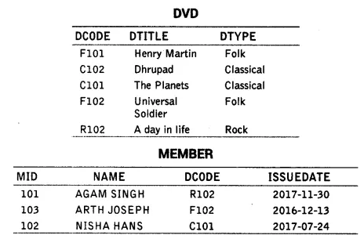
CREATE FOLLOWING TABLES

Slide 213
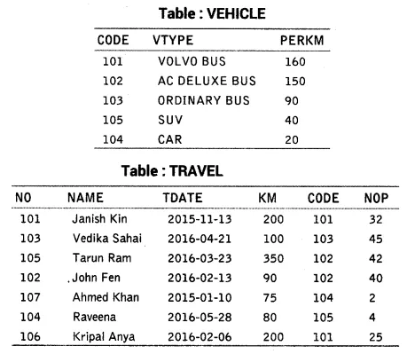
CREATE FOLLOWING TABLES

Slide 214
THANK YOU

